Slide 1
SharePoint APIs
PnP Core CSOM

Slide 3
How to View This Presentation
To switch to Notes Page view:
While in edit mode, click the View tab within the ribbon, and then click Notes Page
To navigate through notes, use the Page Up and Page Down keys
Zoom in or zoom out, if required
In the Notes Page view, you can:
Read any supporting text—now or after the delivery
Add notes to your copy of the presentation, if required
Take the presentation files home with you

Slide 4
Overview
What is PnP Core CSOM
In this Lesson
How to use PnP Core CSOM
When to use PnP Core CSOM
CSOM code samples
Optimizing CSOM requests

Slide 5
Objectives
Learn what PnP Core CSOM is
Know when to use it for your customizations
Discover how it can be used
Be aware of methods to optimize requests

Slide 6

What is PnP Core CSOM
Extension to native SharePoint Client Side Object Model libraries
Developed under The Patterns and Practices initiative
Open Source under MIT license
Retrieves data through the SharePoint CSOM libraries
Eases operations against SharePoint from managed code
Also called PnP Sites Core
https://github.com/SharePoint/PnP-Sites-Core
Notes:
The Patterns and Practices Core CSOM Library is an extension to the native SharePont Client Side Object Model libraries.
Licensed under MIT means it can freely be used for any purpose, both commercial as well as private without having to pay any fees as long as the original disclaimer is copied along in the code.
It uses the native CSOM library to communicate with SharePoint.
It extends native CSOM in many ways and eases working with SharePoint remotely from managed code. It is therefore recommended to be used over the native CSOM libraries.
The PnP Core CSOM library is also referred to as the PnP Sites Core. To elaborate this is an extension to CSOM and should be used in scenarios where you normally would use native CSOM, we call it PnP Core CSOM in this module.

Slide 7
When to use PnP Core CSOM
Developing from managed code (i.e. C#)
I.e. console application, Windows Service, Windows Forms application
Want easy access to all the possibilities SharePoint offers remotely
Backed by a large open source community which allows Pull Requests and issuing tickets
Want to avoid Cross Domain Request challenges
Notes:
If you’re developing from managed code like C#, VB.NET, F# or one of the other .NET Framework languages and you wish to communicate with a SharePoint 2013, 2016 or SharePoint Online environment, PnP Core CSOM can be particularly useful due to its ease of use.
Scenarios where using PnP Core CSOM would be good is when you want to have access and (potentially) use the full range of options available to communicate with SharePoint.
The PnP Core CSOM library is backed by a large open source community with many active participants. The owners of the code repository are also accepting Pull Requests. That means any developer, including you, can influence the direction and functionality exposed in this library. By simple proposing a fix or addition to PnP Core CSOM in a Pull Request on GitHub, the repository owners will judge if they find it an useful contribution and if so, your code will likely be part of the release one month later.
If you’re not so certain about your developer skills that you want to actively participate in writing code for it, you also have the ability on GitHub to submit an issue. Again the community behind this open source will be able to respond and help you out. Do be aware though that it’s an open source project which is not directly supported by Microsoft. So for help you can’t submit a ticket to Microsoft Support and are depending on the willingness of others to spend their spare time on helping you out.
If you’re using client side code like JavaScript, you’re likely going to run into challenges when trying to make requests across two domains. When using managed code, you don’t face this problem.

Slide 8
When not to use PnP Core CSOM
Only in need of basic operations against SharePoint
Want to keep the application footprint small
Adding PnP Core adds 58 DLLs to your project
Notes:
There are also scenarios in which it is not advised to use PnP Core CSOM but instead refrain to use the native SharePoint CSOM. Some of these scenarios would be if you only need basic operations against SharePoint like reading from a list or getting properties of a web. Adding the PnP Core CSOM NuGet Package adds 58 DLL files to your application and therefore has a potential big impact on the footprint and size of your application. If that would be the case, consider just using the native SharePoint CSOM library instead.

Slide 9
PnP Core CSOM vs native CSOM
Creating a new Content Type using native CSOM
// Load the current collection of content types
ContentTypeCollection contentTypes = web.ContentTypes;
web.Context.Load(contentTypes);
web.Context.ExecuteQuery();
ContentTypeCreationInformation newCt = new ContentTypeCreationInformation();
// Set the properties for the content type
newCt.Name = “My CT”;
newCt.Id = “0x0101009189AB5D3D2647B580F011DA2F356FB2”;
newCt.Group = “My custom content types group”;
ContentType myContentType = contentTypes.Add(newCt);
web.Context.ExecuteQuery();
Notes:
To show how much easier PnP Core CSOM can make you coding, consider this sample where a new content type is being created. You can see that quite a few lines are required to perform a relatively simple operation.

Slide 10
PnP Core CSOM vs native CSOM
Creating a new Content Type using PnP Core CSOM
clientContext.Web.CreateContentType(
"My CT",
"0x0101009189AB5D3D2647B580F011DA2F356FB2",
"My custom content types group");
Notes:
If we compare doing the same operation, adding a content type, to doing that with PnP Core CSOM, you can see that this one liner makes it much easier to achieve the same goal.

Slide 11
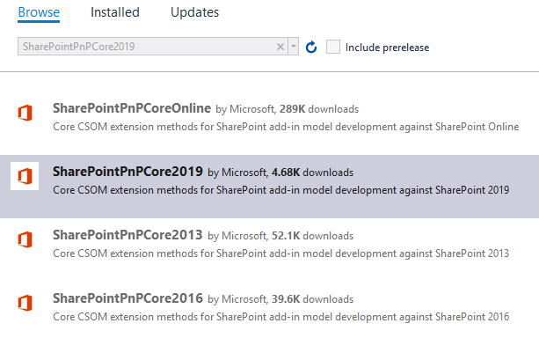
How to use PnP Core CSOM
NuGet
Add the NuGet package
Start coding
Notes:
To use the PnP Core CSOM libraries, you can add one of the following NuGet packages to your Visual Studio solution (names are case sensitive!):
SharePoint 2013: SharePointPnPCore2013
SharePoint 2016: SharePointPnPCore2016
SharePoint 2019: SharePointPnPCore2019
SharePoint Online: SharePointPnPCoreOnline
This will add approximately 58 DLLs to your Visual Studio project with all the possible components of PnP Core CSOM.

Slide 12
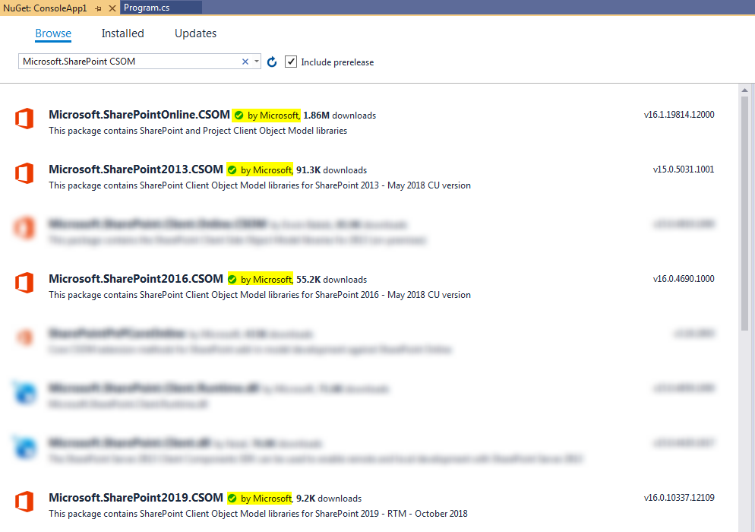
How to Install Native CSOM
NuGet
Add the NuGet package
Start coding
Notes:
To use the native CSOM libraries, you can add one of the following NuGet packages to your Visual Studio solution:
SharePoint 2013: Microsoft.SharePoint2013.CSOM
SharePoint 2016: Microsoft.SharePoint2016.CSOM
SharePoint 2019: Microsoft.SharePoint2019.CSOM
SharePoint Online: Microsoft.SharePointOnline.CSOM
Notice that you take the ones released by Microsoft as there are some other versions available compiled by individuals of which the quality nor safety can be guaranteed.
The version for SharePoint Onlin ewill add 18 DLLs to your Visual Studio project (measured in April 2020, may change over time) with all the possible components of native CSOM.

Slide 13
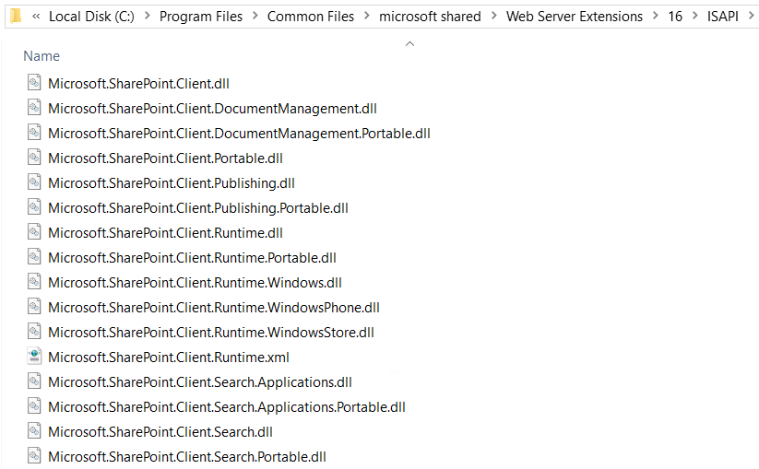
How to use native CSOM
15/16-Hive
Copy out and reference the Microsoft.SharePoint.Client.*.dll libraries
Start coding
Notes:
Another option is to copy the Microsoft.SharePoint.Client.*.dll assemblies from the 15/16-hive of a SharePoint farm machine and reference these in your Visual Studio project.
Full path where to find them:
SharePoint 2013: C:\Program Files\Common Files\microsoft shared\Web Server Extensions\15\ISAPI
SharePoint 2016 & 2019: C:\Program Files\Common Files\microsoft shared\Web Server Extensions\16\ISAPI
This option does not work for SharePoint Online. Use the NuGet package instead in that scenario.

Slide 14
Knowledge Check
What does CSOM stand for?
Code Side Object Model
Client Side Object Model
Core Solution Object Model
Which CSOM library adds fewer DLLs to your project
PnP Core CSOM
Native CSOM
Which CSOM library typically has a shorter syntax
PnP Core CSOM
Native CSOM

Slide 15
Knowledge Check
What does CSOM stand for?
Code Side Object Model
Which CSOM library adds fewer DLLs to your project
Client Side Object Model
Core Solution Object Model
PnP Core CSOM
Native CSOM
Which CSOM library typically has a shorter syntax
PnP Core CSOM
Native CSOM
Notes:
CSOM stands for Client Side Object Model
PnP Core CSOM adds 58 DLLs to your project, Native CSOM adds 18 DLLs to your project
With PnP Core CSOM you can typically use shorter syntaxes to achieve something. Remember the example about adding a content type a few slides back?

Slide 16
Typical CSOM flow
Add CSOM libraries
Create a ClientContext
Get a reference to Web
Define objects and their properties to be loaded into the context
Execute query
Process returned data
Notes:
This slide shows the steps you typically go through to retrieve data from SharePoint from outside SharePoint using CSOM. You first reference the mandatory assemblies. After this you need to establish a ClientContext. This is typically done with the help of the SharePointContext class to abstract how this is done in OAuth. Once you have a ClientContext to work with, you get a reference to the object you wish to retrieve, i.e. a Web. Next step is to specify which properties of this object you wish to retrieve. Once you’ve defined everything you wish to load, you execute the query to retrieve all the items. Finally you can now use the objects you instantiated to start using its data.

Slide 17
Code Sample – Reading data
// Create a new client context (this needs to be disposed)
ClientContext context = new ClientContext("https://dev.contoso.local");
// Set Credentials to be the current user context
context.Credentials = CredentialCache.DefaultNetworkCredentials;
// Define that we want to use the Web object
Web web = context.Web;
// Specify that we only need the Title and Description from the Web object
context.Load(web, w => w.Title, w => w.Description);
// Execute the query to the server to retrieve the requested data
context.ExecuteQuery();
// Use the properties that are now available
Console.WriteLine("Title: " + web.Title + "; Description: " + web.Description);
Notes:
This code sample shows a typical usage of CSOM. Notice how we need a ClientContext first and we create one by passing in the URL to the site to connect to. Once we have the instance, we provide the means to authenticate to SharePoint. In the security module later on in this workshop, we’ll discuss the authentication options in more detail. After that we can retrieve properties by adding them to the Load of the context. Only when we call context.ExecuteQuery() all requests having been added to context.Load or context.LoadQuery will be executed against the SharePoint server and the returns will become available to be used.
//Complete Code
using System;
using Microsoft.SharePoint.Client;
using System.Net;
namespace Microsoft.Workshops.SharePointDev.SharePointApis.DefaultNetworkCredentailsSample
{
class Program
{
static void Main(string[] args)
{
// Create Context
using (ClientContext context = new ClientContext("https://dev.contoso.local"))
{
context.Credentials = CredentialCache.DefaultNetworkCredentials;
//Reference the Web
Web web = context.Web;
//Load specific context items
context.Load(web, w => w.Title, w => w.Description);
//Execute the query to the server
context.ExecuteQuery();
//Output some info about the web
Console.WriteLine("Title: " + web.Title + "; Description: " + web.Description);
Console.ReadLine();
}
}
}
}

Slide 18
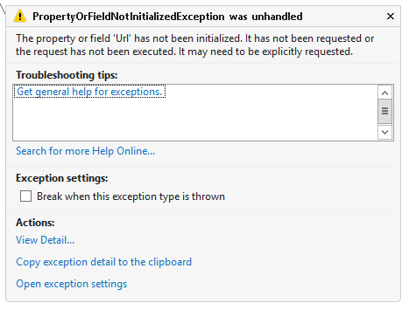
Defining Properties to retrieve
// Load specific context items, but omit the Url property for this sample
context.Load(web, w => w.Title, w => w.Description);
// Retrieve data from SharePoint
context.ExecuteQuery();
// The following line will throw an exception because Url has not been loaded
Console.WriteLine("Url: " + web.Url);
Trying to use properties that have not been loaded will throw an exception
Notes:
The noticeable thing with the previous code sample is that we explicitly specify the properties we are interested in. By doing this we avoid unnecessary data to be sent over the wire that we’re not going to use anyway. This makes the communication and bandwidth usage very efficient. Note though that the objects we’re working with do expose all of the properties. So what happens if we try to use one of the properties that we haven’t (yet) explicitly specified to be loaded is that we’ll see a PropertyOrFieldNotInitializedException.
For more information, see: https://msdn.microsoft.com/en-us/library/office/microsoft.sharepoint.client.propertyorfieldnotinitializedexception(v=office.15).aspx

Slide 19
Code Sample – Writing data
// Create a new client context (this needs to be disposed)
ClientContext context = new ClientContext("https://dev.contoso.local");
// Set Credentials to be the current user context
context.Credentials = CredentialCache.DefaultNetworkCredentials;
// Reference the list where to add a new item in
var list = context.Web.Lists.GetByTitle("Tasks");
// Create a new item in the list
var item = list.AddItem(new ListItemCreationInformation());
// Set the properties of the new list item
item["Title"] = "Your new title";
// Send the request to create the new listitem to SharePoint
item.Update();
context.ExecuteQuery();
Notes:
In this sample we’ll use CSOM to create a new listitem in a list with the title Task. Notice that the list item won’t actually be created until we run context.ExecuteQuery(). Also notice that we don’t explicitly need to retrieve the list we’re adding an item to by placing it in context.Load(list).
//Complete Code
using Microsoft.SharePoint.Client;
using System.Net;
namespace Microsoft.Workshops.SharePointDev.SharePointApis.CreateNewListitem
{
class Program
{
static void Main(string[] args)
{
//Create Context
using (ClientContext context = new ClientContext("https://dev.contoso.local"))
{
context.Credentials = CredentialCache.DefaultNetworkCredentials;
// Reference the list where to add a new item in
var list = context.Web.Lists.GetByTitle("Tasks");
// Create a new item in the list
var item = list.AddItem(new ListItemCreationInformation());
// Set the properties of the new list item
item["Title"] = "Your new title";
// Send the request to create the new listitem to SharePoint
item.Update();
context.ExecuteQuery();
}
}
}
}

Slide 20
Optimizing CSOM
Always limit your request to only the fields that you need
Possible using either Lambda, Linq or CAML
Lambda notation sample
Linq query notation sample
CAML notation sample
context.Load(context.Web,
web => web.Lists
.Include(list => list.Title)
.Where(list => list.BaseType == BaseType.DocumentLibrary));
var query = from list
in context.Web.Lists
where list.BaseType = BaseType.DocumentLibrary select list;
var lists = context.LoadQuery(query.Include( l => l.Title));
var query = new CamlQuery {
ViewXml = "<View>" +
"<ViewFields>" +
“<FieldRef Name='Title' />" +
"</ViewFields>" +
"</View>" };
var listItems = context.Web.Lists
.GetByTitle("Tasks")
.GetItems(query);
context.Load(listItems);
Notes:
As we’ve seen in the previous slides is that we specify the properties we’re interested in. There’s no explicit requirement to do this, but is a best practice. This slide shows you three ways of limiting the results in your query to only what you need.
The sample on the left uses the Lambda notation to specify in 1 request that it only wants all lists within the current web which are of type Document Library and only return the title of these.
The sample in the middle uses the Linq query notation to retrieve only the lists from the current web that are of type Document Library. This syntax does not allow specifying only to retrieve specific fields.
The sample on the right uses a CAML query to retrieve only the Title of each listitem in the Task list on the current web. It could further be expanded with a <Query>…</Query> node to filter down the results based on specific conditions.
The syntax on the left in the Lambda notation sample is the most used syntax.
More information about these options:
https://docs.microsoft.com/en-us/previous-versions/office/developer/sharepoint-2010/ee539350(v%3Doffice.14)
//Complete Code
using System;
using Microsoft.SharePoint.Client;
using System.Net;
using System.Linq;
namespace Microsoft.Workshops.SharePointDev.SharePointApis.OptimizingSample
{
class Program
{
static void Main(string[] args)
{
using (ClientContext context = new ClientContext("https://dev.contoso.local"))
{
context.Credentials = CredentialCache.DefaultNetworkCredentials;
// Sample using Lambda Notation
LinqExpressionSample(context);
// Sample using Linq Query Notation
LinqQueryNotationSample(context);
// Sample using the CAML Query Notation
CamlQueryNotationSample(context);
Console.ReadLine();
}
}
/// <summary>
/// Sample using Lambda Notation
/// </summary>
/// <param name="context">ClientContext to use to communicate with SharePoint</param>
private static void LinqExpressionSample(ClientContext context)
{
context.Load(context.Web,
web => web.Lists
.Include(list => list.Title)
.Where(list => list.BaseType == BaseType.DocumentLibrary));
context.ExecuteQuery();
Console.WriteLine("Lambda Notation");
foreach (var list in context.Web.Lists)
{
Console.WriteLine($"- {list.Title}");
}
}
/// <summary>
/// Sample using Linq Query Notation
/// </summary>
/// <param name="context">ClientContext to use to communicate with SharePoint</param>
private static void LinqQueryNotationSample(ClientContext context)
{
var query = from list
in context.Web.Lists
where list.BaseType == BaseType.DocumentLibrary
select list;
var lists = context.LoadQuery(query.Include(l => l.Title));
context.ExecuteQuery();
Console.WriteLine("Linq Query Notation");
foreach (var list in lists)
{
Console.WriteLine($"- {list.Title}");
}
}
/// <summary>
/// Sample using the CAML Query Notation
/// </summary>
/// <param name="context">ClientContext to use to communicate with SharePoint</param>
private static void CamlQueryNotationSample(ClientContext context)
{
var query = new CamlQuery
{
ViewXml = "<View>" +
"<ViewFields>" +
"<FieldRef Name='Title' />" +
"</ViewFields>" +
"</View>"
};
var listItems = context.Web.Lists.GetByTitle("Tasks").GetItems(query);
context.Load(listItems);
context.ExecuteQuery();
Console.WriteLine("CAML Query Notation");
foreach (var listItem in listItems)
{
Console.WriteLine($"- {listItem["Title"]}");
}
}
}
}

Slide 21
Knowledge Check
Name a valid scenario for using CSOM
Which two steps do you always need to do to retrieve data through CSOM
Console application that pulls data from SharePoint
Queue the data retrieval using clientContext.Load or clientContext.LoadQuery
Windows Service that writes data to SharePoint
…
Execute the queued data using clientContext.ExecuteQuery
What can you do to limit network traffic and server load when using CSOM
Only request the properties you need by using the Lambda, Linq or CAML notation

Slide 22
Lesson Summary
CSOM stands for Client Side Object Model
CSOM can be used to retrieve data from and write data to SharePoint remotely
Requests through CSOM are only executed when calling ExecuteQuery
PnP Core CSOM extends native CSOM allowing easier syntax

Slide 23
Questions?

Slide 24
Lab: Working with CSOM
In this lab, you will create a Windows Console application that leverages the PnP Core CSOM libraries to retrieve all tasks from a Task list that are past due and display them on the screen
Time estimation: 30 minutes
Notes:
Have the students choose either this lab or the one on the next slide, whichever they find more interesting. Note that this lab is way shorter in duration than the next one, so ensure your entire class with this lab or the other lab, but don’t mix it or one part of your class will be done way sooner than the other.
Lab content can be found under “Lab - Working with CSOM”

Slide 25
Lab: Site provisioning using CSOM
In this lab, you will learn how to create a simple site collection provisioning engine from a SharePoint list using Visual Studio 2019
Time estimation: 60 minutes
Notes:
Have the students choose either this lab or the one on the previous slide, whichever they find more interesting. Note that this lab is way longer in duration than the previous one, so ensure your entire class goes with this lab or the other lab, but don’t mix it or one part of your class will be done way sooner than the other.
Lab content can be found under “Lab - Site provisioning using CSOM”

Slide 26
Provider and Endpoint Examples
Search CSOM
using (ClientContext clientContext = new ClientContext(“https://dev.contoso.local”))
{
KeywordQuery keywordQuery = new KeywordQuery(clientContext);
keywordQuery.QueryText = “Microsoft”;
SearchExecutor searchExecutor = new SearchExecutor(clientContext);
ClientResult<ResultTableCollection> results = searchExecutor.ExecuteQuery(keywordQuery);
clientContext.ExecuteQuery();
}

Slide 27
Questions?

